Slide 1
CS35L – Fall 2018
Slide set: | 9.1
Slide topics: | Source control, Git
Assignment: | 9

Slide 2
Software development process
●
Involves making a lot of changes to code
New features added Bugs fixed
Performance enhancements
–
–
–
●
Software team has many people working on the same/different parts of code
Many versions of software released
●
–
Ubuntu 10, Ubuntu 12, etc
Need to be able to fix bugs for Ubuntu 10 for customers using it, even though you have shipped Ubuntu 12.
–

Slide 3
Source/Version Control
●
Track changes to code and other files related to the software
–
What new files were added? What changes made to files?
Which version had what changes? Which user made the changes?
–
–
–
●
Track entire history of the software Version control software
●
–
GIT, Subversion, Perforce

Slide 4
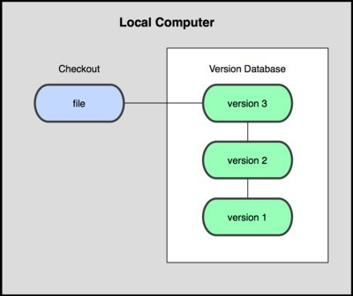
Local VCS
●
Organize different versions as folders on the local machine
No server involved
Other users should copy it via disk/network
●
●
Image Source: git-scm.com

Slide 5
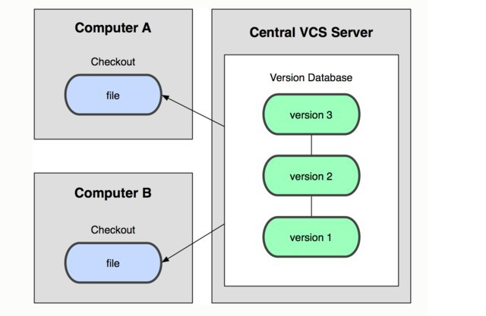
Centralized VCS
●
Version history sits on a central server
Users will get a working copy of the files
Changes have to be committed to the server
All users can get the changes
●
●
●
Image Source: git-scm.com

Slide 6
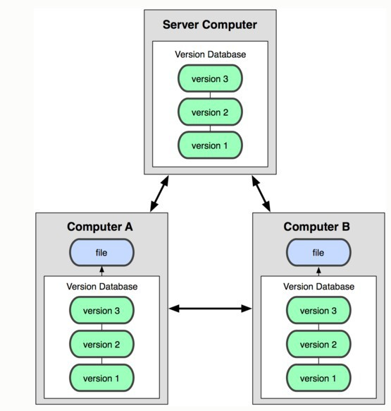
Distributed VCS
Version history is replicated at every user's machine
Users have version control all the time
Changes can be communicated between users
Git is distributed
●
●
●
●
Image Source: git-scm.com

Slide 7
Terms used
●
Repository
–
Files and folder related to the software code Full History of the software
–
●
Working copy
–
Copy of software's files in the repository
●
Check-out
–
To create a working copy of the repository
●
Check-in / Commit
–
Write the changes made in the working copy to the repository
Commits are recorded by the VCS
–

Slide 8
GIT Source control

Slide 9
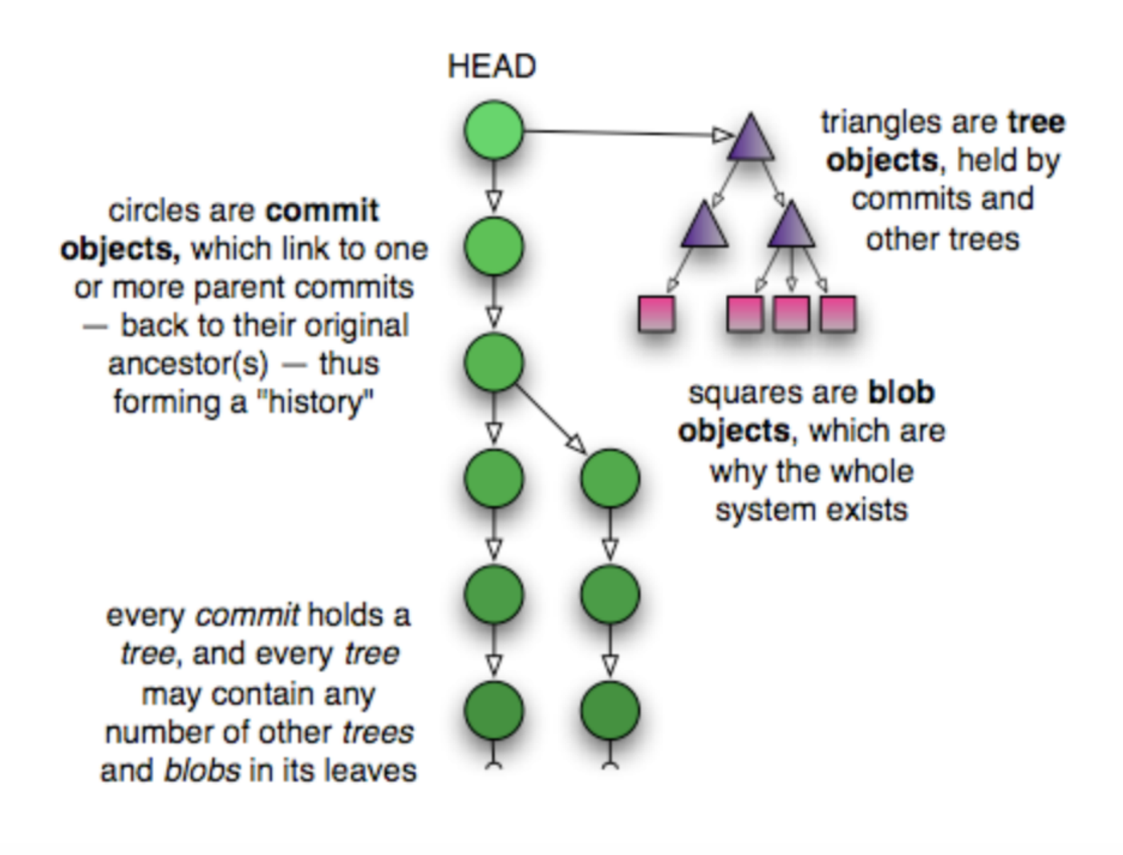
GIT Repository Objects

Slide 10
GIT Repository Objects
Blobs (Binary Large Objects):
When we git add a file such as example_file.txt, git creates a blob object containing the contents of the file. Blobs are therefore the git object type for storing files.
Trees
The tree object contains one line per file or subdirectory, with each line giving file permissions, object type, object hash and filename. Object type is usually one of “blob” for a file or “tree” for a subdirectory
Commit
The commit object contains the directory tree object hash, parent commit hash, author, committer, date and message.
Tags
The tag object type contains the hash of the tagged object, the type of tagged object (usually a commit), the tag name, author, date and message
Objects uniquely identified with hashes
https://matthew-brett.github.io/curious-git/git_object_types.html

Slide 11

Git States
Index(cache)
git checkout
git add
git commit
Image Source: git-scm.com

Slide 12
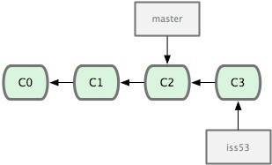
Terms used
HEAD
Refers to the currently active head
Refers to a commit object
Branch
Refers to a head and its entire set of ancestor commits
Master
Default branch
Image Source: git-scm.com

Slide 13
Git commands
●
Repository creation
–
$ git init
$ git clone
(Start a new repository)
(Create a copy of an exisiting repository)
–
●
Branching
–
$ git branch <new_branch_name>
$ git checkout <tag/commit> -b <new_branch_name> (creates a new branch)
●
Commits
–
$ git add
$ git commit
(Stage modified/new files)
(check-in the changes to the repository)
–
●
Getting info
–
$ git status
$ git diff
$ git log
$ git show
(Shows modified files, new files, etc) (compares working copy with staged files) (Shows history of commits)
(Show a certain object in the repository)
–
–
–
●
Getting help
–
$ git help

Slide 14
First Git Repository
$ mkdir gittest
$ cd gittest
$ git init
creates an empty git repo (.git directory with all necessary subdirectories)
$ echo “Hello World” > hello.txt
$ git add .
Adds content to the index
Must be run prior to a commit
$ git commit –m “Check in number 1”

Slide 15
Working With Git
$ echo “I love Git” >> hello.txt
$ git status
Shows list of modified files
hello.txt
$ git diff
Shows changes we made compared to index
$ git add hello.txt
$ git diff
No changes shown as diff compares to the index
$ git diff HEAD
Now we can see changes in working version
$ git commit –m “Second commit”

Slide 16
Working With Branches
$ git branch test
Create new branch
$ git branch
Lists all branches
$ git checkout test
Switch to test branch
$ echo “hello world!” > hw
$ Commit the change in new branch
$ git checkout master
Back to master branch
$ git log
$ git merge test
Merges commits from test branch to current branch(here master)

Slide 17
Git integrating changes
Required when there are changes in multiple branches
Two main ways to integrate changes from one branch to another – merge and rebase
Merge is simple and straightforward
Rebase is much cleaner

Slide 18
Git merge

Slide 19
Git rebase

Slide 20
Merge Conflicts
Usually git will do merge automatically
Conflict arises when you changed the same part of the same file differently in the two branches you’re merging together
The new commit object will not be created
You need to resolve conflicts manually by selecting which parts of the file you want to keep

Slide 21
More Git Commands
●
Reverting
–
$ git checkout HEAD main.cpp
●
Gets the HEAD revision for the working copy
–
$ git checkout -- main.cpp
●
Reverts changes in the working directory
–
$ git revert
●
Reverting commits (this creates new commits)
●
Cleaning up untracked files
–
$ git clean
●
Tagging
–
Human readable pointers to specific commits $ git tag -a v1.0 –m 'Version 1.0'
–
●
This will name the HEAD commit as v1.0

Slide 22
Assignment 9
Deadline (No late Submission!)
Friday Dec 07, 11:55 PM

Slide 23
Lab 9
Fix an issue with diff diagnostic - apply a patch to a previous version
Installing Git
Ubuntu: $ sudo apt-get install git
SEASnet
Git is installed in /usr/local/cs/bin
Add it to PATH variable or use whole path
$ export PATH=/usr/local/cs/bin:$PATH
Make a directory ‘gitroot’ and get a copy of the Diffutils Git repository
$ mkdir gitroot
$ cd gitroot
$ git clone <URL>
Follow steps in lab and use man git to find commands

Slide 24
Hints
git clone
git log
git tag
git show <hash>
git checkout v3.0 –b <branchname>

